Slide 1
USEPA Brownfield Cleanup Grant & Funding Opportunity
Funding Opportunity No. EPA-I-OLEM-OBLR-25-07
January 8, 2026

Slide 2
Agenda
1
EPA Brownfields Program & Application Overview
2
Site Background & Environmental History
3
Proposed Cleanup Efforts
4
Community Beneficial Reuse
5
Timeline & How to Stay Involved

Slide 3
EPA Brownfields Program & Application Overview
Purpose
Mullica Township is seeking funds to remediate priority areas of concern at the Former Joseph Perona Scrapyard Facility, including stockpiled contaminated soils and solid waste
The work will be completed in accordance with NJDEP remediation requirements under the supervision of the Licensed Site Remediation Professional the Township will retain for the site
Request
Mullica Twp. is seeking $4 million in EPA Brownfields Cleanup funding
If awarded, the grant funds will support cleanup of the priority areas of concern
Goals
Secure site and prevent public access
Remove contaminated soil/solid waste
Support eventual beneficial reuse
Foster public involvement to provide feedback and community reuse needs
This meeting is an important part of the application process!
Notes:
The work will be completed in accordance with NJDEP remediation requirements under the supervision of the Licensed Site Remediation Professional the Township has retained for the site

Slide 4
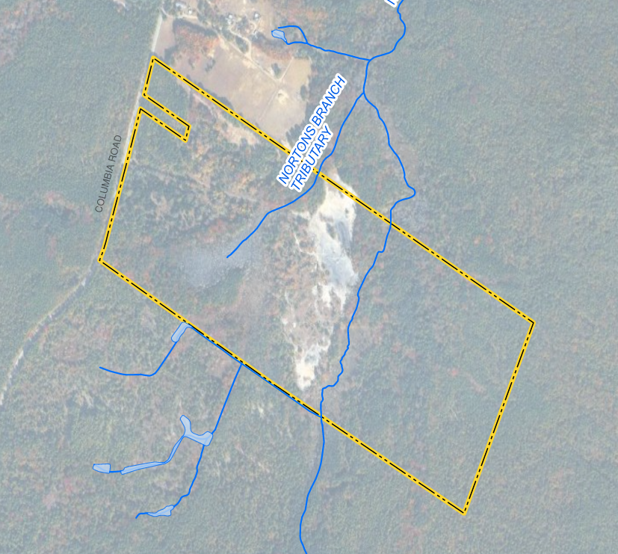

Site Background - Former Joseph Perona Scrapyard
Address - 1801 Columbia Road, Mullica Township (Block 2401, Lot 10) | 99-acres
1960s – First developed for agricultural use with blueberry farming in the area
1970s – Use transitioned from agricultural to scrapyard operations (Joseph Perona Scrapyard)
1980s – Municipality and NJDEP flag junkyard ordinance violations, issues with lead smelting, ash/debris piles, burn pits, and oil staining
1986 – Two major tire fires (~500,000 tires)
1990s – NJDEP involvement increases and investigation activities escalate, property remains blighted
2008 - Township of Mullica acquires the property via tax foreclosure
Today – Property remains vacant, large contaminated soil and debris piles remain.
Notes:
Joseph Perona Scrapyard Operations
For nearly two decades, activities included wire burning and lead smelting, extensive tire storage and burning, and open disposal of solid waste and drums of unknown contents.
May 1, 1986, Tire Fire: two separate fires (one reportedly started by owner for wire/rim separation; a second by alleged arsonist); 25,000–50,000 tires consumed; runoff reached Norton’s Creek, which flows to the Mullica River.
These practices generated ash deposits and waste piles that remain today.
The scrapyard ceased operations in the 1990s, leaving behind widespread contamination and environmental concerns.
Mullica Township acquired the property through tax foreclosure on December 1, 2008 and is exempt from Spill Act liability under New Jersey law as a sovereign acquisition of tax delinquent property.
The site is not listed on the National Priorities List (NPL) and cleanup will proceed under NJDEP oversight.
Today
Property encompasses approximately 99 acres of vacant, partially forested land interspersed with cleared areas and designated wetlands (55-acres).
Two branches of the North Branch Tributary traverse the parcel from northeast to southwest, ultimately draining toward Norton’s Creek and the Mullica River;
Increasing the potential for contaminant migration to sensitive aquatic habitats.

Slide 5
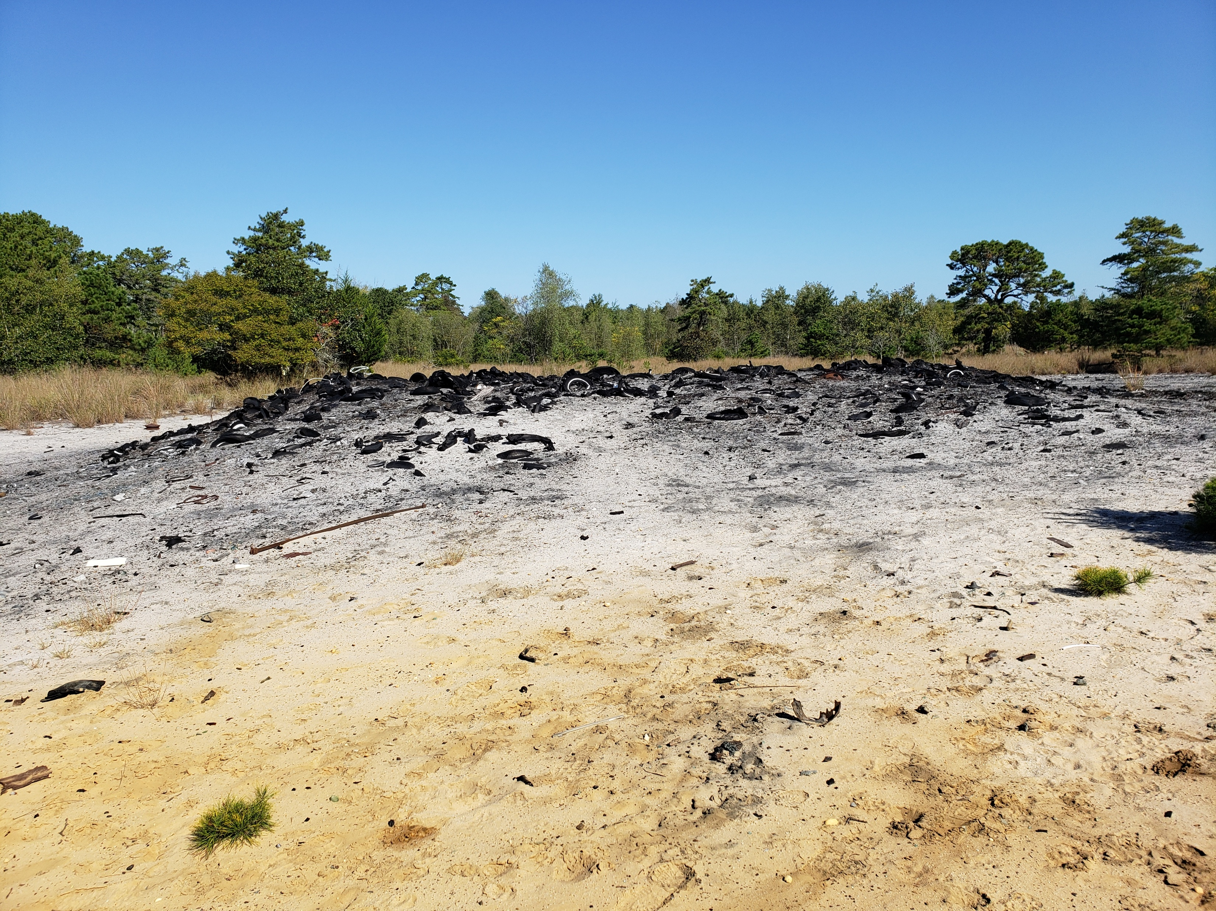
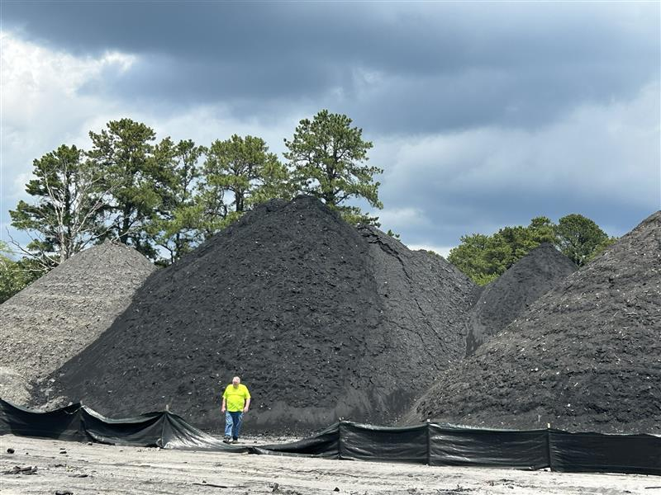
Environmental History
Former Joseph Perona Scrapyard – NJDEP Program Interest No. G000000472
1980s – Numerous NJDEP and Township compliance issues, Notice of Violation and directives issued to Perona requiring investigation of waste, soil, and ground water.
1986 – NJDEP collects soil/water samples at 14 locations, elevated metals and PCBs found in soils
1990s – Groundwater sampling found high levels of zinc and lead/soil/ash sampling finds elevated lead and PCB concentrations.
1991 – USEPA declines CERCLA removal action and funding support, defers to NJDEP Bureau of State Case Management
2000 – On January 1, 2000 NJDEP received a Hazardous Discharge Site Remediation Fund (HDSRF) Grant Application Package from Schoor DePalma Inc. on behalf of Mullica Township
Notes:
1980s
NJDEP first became involved in the subject site as the result of a May 1, 1986 tire fire. ~50,000 tires consumed in fire resulting in increase in contamination spread
Some NJDEP inspections reported that the property appeared to contain as many as 2 million tires and over one thousand cars and trucks.
Investigations initiated in the late 1980s and continuing through the 2000s (NJDEP Case/Program Interest No. G000000472) confirmed the presence of hazardous substances including lead, zinc, copper, PCBs, PAHs, phthalates, TPHCs, pesticides, and dioxins/furans in soils and sediments.
Historic runoff transported contaminants toward Norton’s Creek, creating risks for downstream irrigation and ecological receptors.
A major tire fire in 1986 further exacerbated contamination.
EPA representatives generated a Pollution Report dated May 5, 1986 with regard to the May 1, 1986 tire fire
Perona required to drum characterization, soil sampling (lead smelting waste, ash piles, buried garbage pit, oil staining), and installation of monitoring wells for groundwater assessment.
Early 2000s
On January 1, 2000 NJDEP received a Hazardous Discharge Site Remediation Fund (HDSRF) Grant Application Package from Schoor DePalma Inc. on behalf of the Township of Mullica. The package included a proposal for a site investigation pursuant
NJDEP Case No. 00-02-17-0323-58 assigned to the Site on Feb. 17, 2000

Slide 6
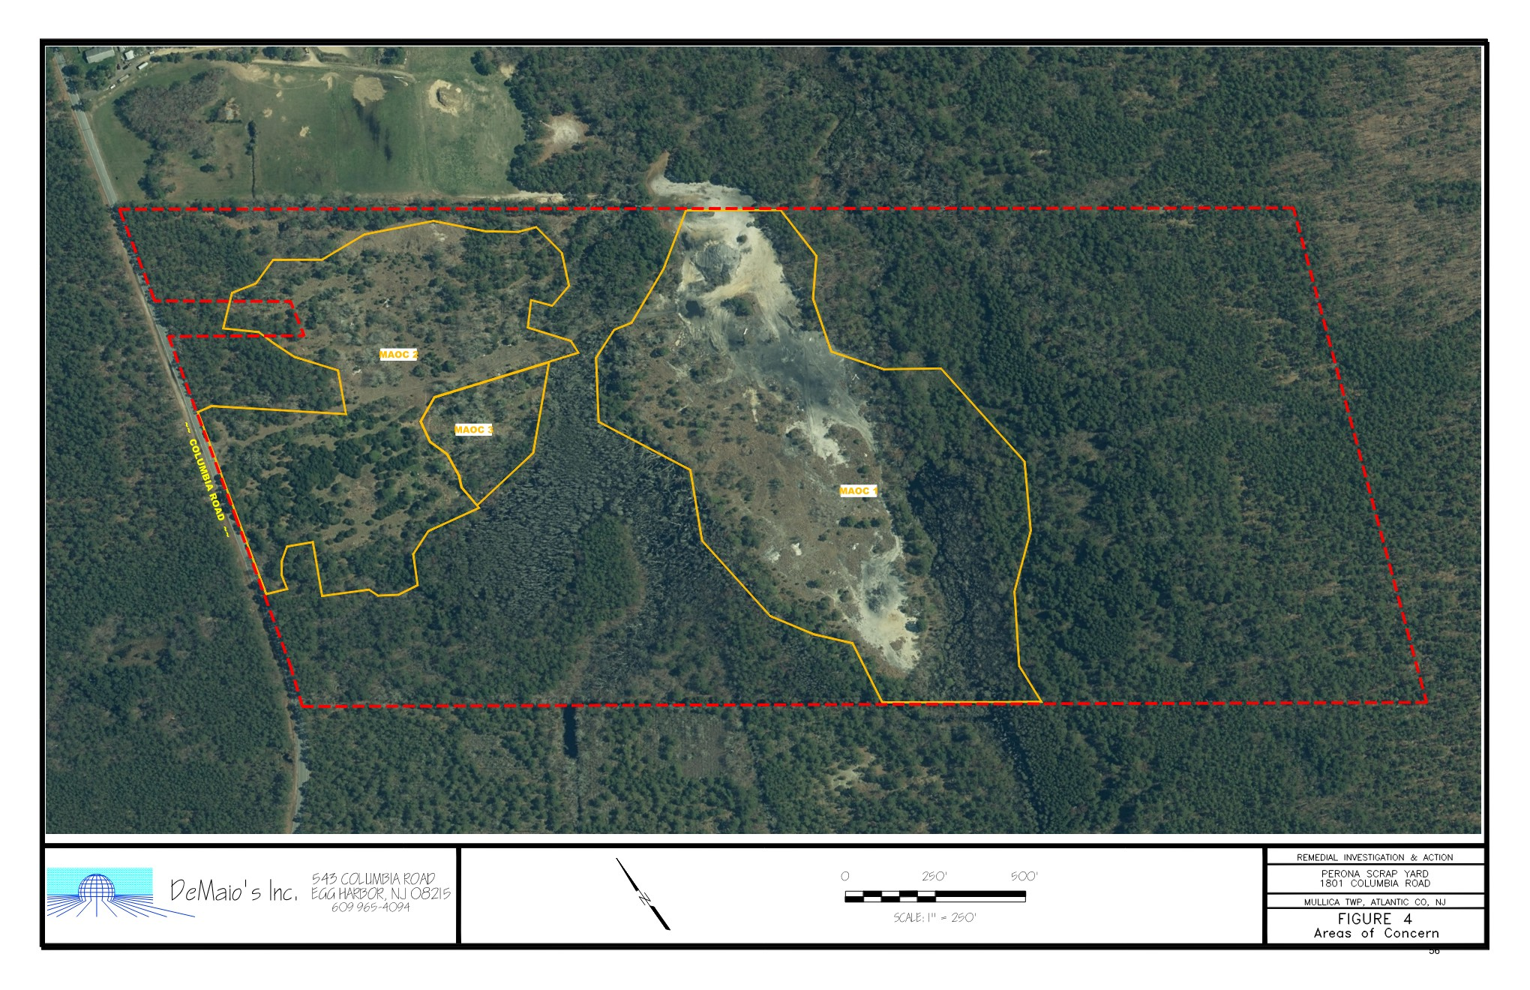
Environmental History
Former Joseph Perona Scrapyard – NJDEP Program Interest No. G000000472
2000 – Mullica Township awarded $164,996 by NJDEP through HDSRF Grant for Preliminary Assessment / Site Investigation Activities
2003 – Site Investigation
Three Major Areas of Concern (MAOC) found: MAOC 1) Eastern Disposal Area, MAOC 2) West Disposal Area , and MAOC 3) Residential Structures Area
Sampling confirms presence of hazardous substances including lead, zinc, copper, PCBs, PAHs, phthalates, TPHCs, pesticides, and dioxins/furans in soils, sediments, and groundwater
2006 – Cleanup work removes ~216,000 tires
2010 – Cleanup work removes ~20,000 tires with County/NJ support, reducing blight and fire hazards
MAOC 2
MAOC 3
MAOC 1
$567,500 via NJDEP/Atlantic County Scrap Tire Management Fund
Notes:
Large-scale tire removals were completed in 2006 (approx. 216,000 tires) and 2010 (approx. 20,000 tires) which removed a significant portion of solid waste/source material at the Site, residual contamination persists across multiple disposal areas and burn zones.

Slide 7

Environmental History
Former Joseph Perona Scrapyard – NJDEP Program Interest No. G000000472
2024 – NJDEP issued Conditional Approval of a Solid Waste Corrective Action Plan requiring removal of remaining visual solid waste and remediation of remaining contamination.
However, completion of these efforts has proven challenging to the limited resources available to Mullica Township.
2025 – Township contracts additional cleanup work
Removal of solid waste
Remaining 7,800 tons of contaminated soil segregated and stockpiled
Waste classification sampling completed in preparation for future disposal
Soil stockpile staged on plastic sheeting to prevent further discharge to nearby wetlands and sensitive ecological areas
Notes:
2024 - NJDEP’s Bureau of Solid Waste Compliance & Enforcement issued Conditional Approval of a Solid Waste Corrective Action Plan requiring removal of visual solid waste, GPS documentation of suspect areas, and coordination with the CSR&R (ARRCS) program for remediation of remaining contamination. However, completion of these efforts has proven challenging to the limited resources available to Mullica Township.
Township coordination with NJDEP Solid Waste and CSR&R programs proceeding under Conditional Approval.

Slide 8
Today’s Challenges
Former Joseph Perona Scrapyard – NJDEP Program Interest No. G000000472
Approximately 7,800 tons of impacted soils remain stock-piled at the Site.
Site continues to pose direct-contact and inhalation risks incase of inadvertent public access
Need to secure site from public access through signage, fencing, and other preventative measures
Remaining contamination threatens ecological receptors and groundwater quality in an area reliant on private wells
Brownfields EPA funding is essential to implement a comprehensive cleanup that addresses the remaining contamination, eliminates exposure pathways, and prepares the property for safe reuse.
Brownfield Focus
If awarded, the cleanup will focus on the contaminated soil and solid waste stockpiles as the main priority
Additional Investigation Needed
Township pursuing additional funds through HDSRF Grant to further investigate remaining soil, groundwater, and ecological impacts

Slide 9
Proposed Cleanup Efforts
Former Joseph Perona Scrapyard – NJDEP Program Interest No. G000000472
Brownfield Cleanup Priorities
1) Installation of site security (fencing, signage, etc.)
2) Removal of any remaining visual solid waste piles
3) Completion of supplemental soil/waste classification sampling
4) Disposal of approximately 7,800 tons of stockpiled/impacted soil material for disposal at an appropriate off-Site facility
Completion of Analysis of Brownfields Cleanup Alternatives Underway
Evaluates and compares feasible cleanup options for a Brownfields Site
Identifies a remedy that is protective of human health and the environment and appropriate for the site’s planned/potential reuse.
Demonstrates that the selected cleanup approach is cost-effective, implementable, and consistent with applicable regulatory requirements.
Notes:
Following cleanup, the Township envisions restoring the site for compatible open space and ecological enhancement consistent with the Pinelands Comprehensive Management Plan in addition to pursing renewable energy infrastructure installation. This reuse will improve water quality, reduce flood risk, and provide long-term community benefits through nature-based recreation, habitat restoration, short-term job growth, and long-term energy sustainability.

Slide 10
Community Beneficial Reuse
Former Joseph Perona Scrapyard – NJDEP Program Interest No. G000000472
Benefits
Protect Health: Remove/contain sources; reduce exposure for children, seniors, and sensitive populations
Environmental Gains: Improve water quality; stabilize soils; restore habitat and buffers in Pinelands ecosystem
Quality-of-Life: Remove blight; enhance safety; enable nature-based recreation and education
Reuse Potential
Open space & ecological restoration consistent with Pinelands Comprehensive Management Plan
Green infrastructure: Native plantings, riparian buffers, stormwater attenuation.
Community solar infrastructure installation consistent with the Township’s existing Memorandum of Understanding (Oct 2025) with a Conditional Redeveloper to evaluate a solar feasibility at contaminated/landfill sites
Flood-compatible amenities and resilience features in mapped Zone A areas.
Notes:
Following cleanup, the Township envisions restoring the site for compatible open space and ecological enhancement consistent with the Pinelands Comprehensive Management Plan in addition to pursing renewable energy infrastructure installation. This reuse will improve water quality, reduce flood risk, and provide long-term community benefits through nature-based recreation, habitat restoration, short-term job growth, and long-term energy sustainability.
Mullica Township’s Community Solar MOU project is a forward-looking initiative to evaluate the potential redevelopment of a closed landfill/brownfield area for community solar generation, contingent upon successful environmental remediation and regulatory approvals. Through a Memorandum of Understanding (MOU) with a conditional solar developer, Mullica Township has established a non-binding framework to explore technical feasibility, interconnection potential, regulatory compliance, and community benefits associated with a low-impact renewable energy reuse consistent with Pinelands constraints.
The project is intended to advance clean energy access without disturbing sensitive natural resources, provide long-term municipal and community benefits, and align with state and regional climate and sustainability goals. Importantly, the MOU does not commit the Township to construction; rather, it positions the site for future funding, planning, and implementation once contamination is addressed. EPA Brownfields cleanup funding is a critical prerequisite to this effort, as it would remove environmental barriers, reduce liability, and make the site eligible for clean-energy reuse that supports environmental protection, resiliency, and potential cost savings for residents through community solar participation.

Slide 11

Timeline & How to Stay Involved
Former Joseph Perona Scrapyard – NJDEP Program Interest No. G000000472
Timeline
January 8 - January 20 - Public Comment period
January 28, 2026 – Application submission
May 2026 – Anticipated notification by EPA
October 1, 2026 – If awarded, grant period starts
November 2026-2028 – Cleanup efforts to begin
Site security measures to be installed
Confirmatory waste classification sampling
Solid waste disposal
Contaminated soil removal
September 30, 2030 – Grant period concludes
Stay Involved
Visit mullicatownship.org
Meeting Notices
Draft Application
Application & Project Status
How to Join Advisory Committee
Submit comments, questions, concerns to:
Dawn Stollenwerk
Township Chief Financial Officer
Dstollenwerk@mullicatownship.org.
Notes:
Talk through how there will be an advisory committee, more information to come,

Slide 12
Thank you
Lauren Rojewski (Assistant Project Manager)
Mark Pietrucha, PE, LSRP (Principal)

